Slide 1
Request regarding PQC Chart Update
23rd Dec 2025
SAG PQC Taskforce Team

Slide 2
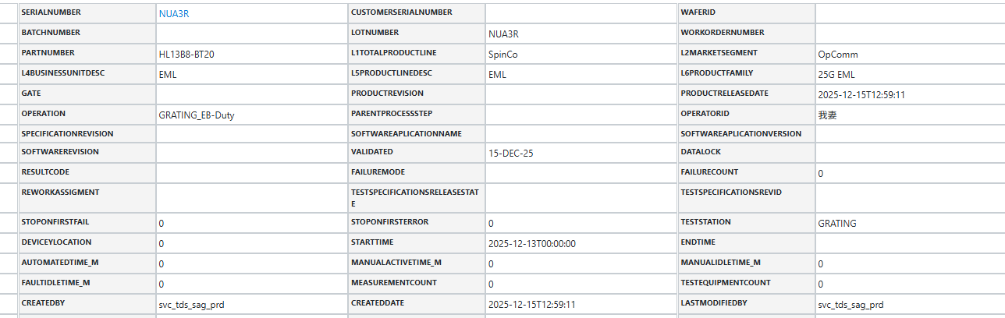
A. Regarding the Update of the PQC Chart
Recently, it appears that the data in the PQC charts has not been updated to the latest version. There are no errors shown in the Python code, but the latest data has not been updated in KTDS.Could you please help resolve this issue?Thank you for your cooperation.
For Example
・Latest KTDS HL13B8(GRATING_EB-Duty) Information (as of Dec 22nd).
・The source manufacturing file contains data up to December 21, but KTDS only has data up to December 15.

Slide 3
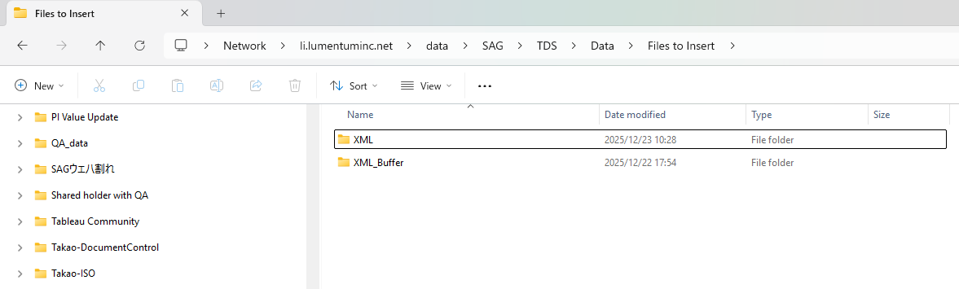
\\li.lumentuminc.net\data\SAG\TDS\Data\Files to Insert
We confirmed that collected data by pycode has been gathered into the Box.
The transformation from this xml folder to K-TDS, looks not well.
-> Please check the system.

Slide 4
Thank you

